Slide 1

Osceola Transportation
Southeast Area Transportation Study – SEATS
Community Information Meeting
March 22, 2023
Notes:
Welcome to the public meeting for Osceola County’s Southeast Area Transportation Study, also known as SEATS. This project comes in response to community concerns about planned developments and inability of the existing roadways to safely accommodate increased traffic.
The purpose of tonight’s meeting is to explain how Osceola County is working with the 12 major developers within the Mixed-Use Districts south and east of Lake Toho to develop a plan to improve area transportation facilities. The study includes the areas East of Lake Toho and South of Lake Toho, the Alligator Chain of Lakes Mixed-Use Conceptual Master Plan areas, as well as the surrounding communities.

Slide 2
Title VI Compliance
Osceola County values diversity and welcomes input from all interested parties regardless of cultural identity, background, or income level. Osceola County shall not exclude participation in, deny benefits of, or subject to discrimination anyone on the grounds of race, color, national origin, sex, age, disability, religion, or familial status.
For questions about Title VI, please contact:
Civil Rights Program Coordinator
1 Courthouse Square, Suite 4200
Kissimmee, FL 34741
407-742-1200 or
TTD: 800-955-8771
ADA.Coordinator@osceola.org
Notes:
Osceola County values diversity and welcomes input from all interested parties regardless of cultural identity, background, or income level. Osceola County shall not exclude participation in, deny benefits of, or subject to discrimination anyone on the grounds of race, color, national origin, sex, age, disability, religion, or familial status. For questions about Title VI, please contact the Civil Rights Program Coordinator by mail at….

Slide 3
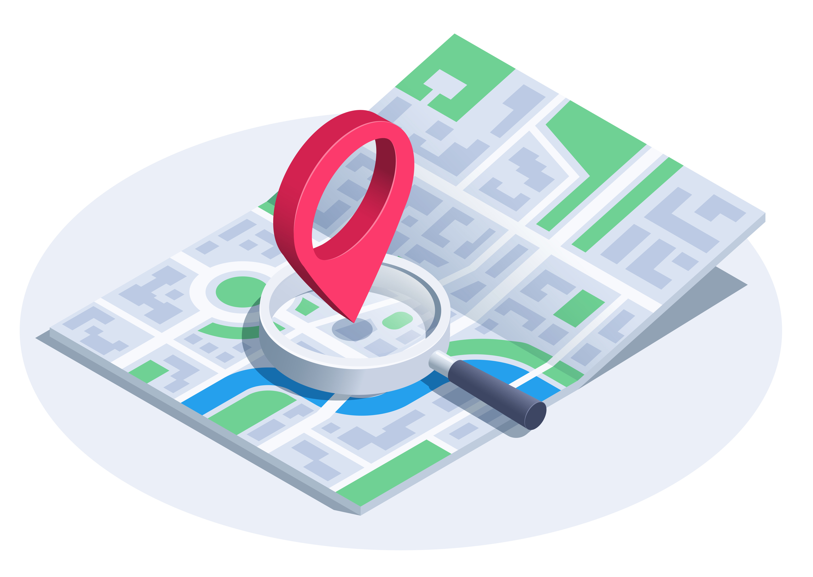

More About SEATS
Evaluate transportation network
Identify impact to the network
Identify number of lanes needed
Identify timing and phasing of needed improvements
Impact on specific roadway segments
Notes:
The goal of the SEATS study isto evaluate the transportation network through the planning horizon year of 2045, identify the impact to the network from the 12 developers and identify the number of lanes that will be needed within the roadway system in 2045. Further, the study seeks to identify the timing and phasing of needed improvements at 5-year increments, and indicate the developer’s percentage of impact on the specific roadway segments as a proportionate share of the total trips in 2045.

Slide 4
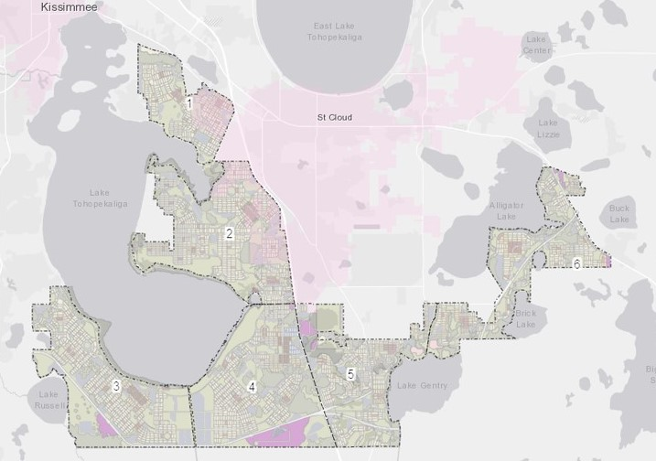
Mixed-Use District (MXD) History
Conceptual Master Plans
Notes:
This map shows the Mixed-Use Districts analyzed in this study. The districts are designated for future development as part of the 2040 Comprehensive Plan. With this significant growth, we are actively planning for transportation infrastructure improvements to accommodate the traffic demands.
To allow for transportation infrastructure projects to occur in concert with the planned developments, Osceola County is pursuing innovative funding strategies, including partnerships with area developers.
Osceola County has entered into Transportation Collaboration Agreements, or TCA’s, with the 12 developers. The agreements essentially state the developers would accept the findings of the final SEATS study and will enter into subsequent agreements to implement the needed improvements based on their development’s impact to the transportation system.

Slide 5
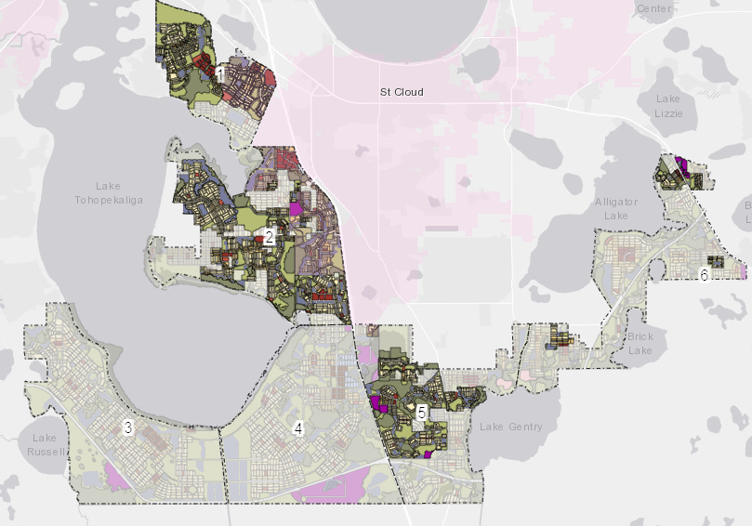
SEATS Study: Goal, Approach, and Methodology
Edgewater
East
Shores
Edgewater
West
Monterey
Amavi
Whaley
Approach:
Evaluate the existing and projected traffic on the SEATS Roadway Network:
Evaluate a detailed 2045 buildout of the SEATS developments
Update of the roadway network based on best available data
Identify trips based on developer provided buildout data
Bellatara
Fontana
Hickory
Village
Canoe Creek
Lake Gentry
Landings
Green Island
Notes:
The first step was to determine existing and projected traffic on the Southeast Area Transportation Study roadway network. This was done by evaluating a detailed 2045 buildout of the SEATS developments and updating the roadway network based on the best available data. The vehicle trips were derived from the developer-provided buildout data.
This information and related analysis allowed Osceola County to develop a segment analysis spreadsheet to identify the developer’s proportionate share of added trips, and thus proportionate share of future transportation improvements.

Slide 6
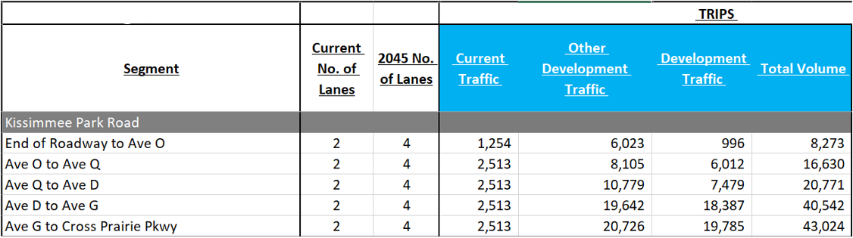
SEATS Traffic Volumes (Sample Corridor)
Southeast Area Transportation Study – SEATS
Notes:
This slide uses Kissimmee Park Road as an example of how the SEATS analysis identified the current number of lanes, the necessary number of lanes in 2045, the current traffic, other development traffic that is not attributed specifically to the 12 developments, the anticipated development traffic of the 12 developments, and combined all the data for a total projected traffic volume. These numbers were then further evaluated to determine the proportionate share that each developer should be responsible for in each segment of roadway.

Slide 7
SEATS Roadway Network Map
Southeast Area Transportation Study – SEATS
Legend
2 lanes
4 lanes
6 lanes
8 lanes
Planning Purposes Only
Subject to funding availability
Notes:
This map of the Southeast Area Transportation Study Roadway Network shows the number of lanes needed in 2045 based on future traffic volumes. The streets shown in purple planned 2-lane framework roads such as Deer Run Road, Lakeshore Blvd and Michigan Ave. The streets shown in green, such as Hickory Tree Road and Canoe Creek Road, will need 4 lanes. The study also showed U.S. 192 (highlighted in orange) would need six lanes, while the segment of Florida’s Turnpike shown in red will require 8 lanes to accommodate future traffic.​

Slide 8

SEATS Roadway Phasing Plans
Background
Goal:
Understand roadway improvement priorities.
Approach:
Evaluate the roadway segment needs for five-year intervals based on the:
  Detailed buildout/phasing plans of the SEATS developments.
  Estimated roadway segment traffic operations (i.e. Level of Service, volume to capacity ratio).
  Expected travel patterns.
Notes:
A goal of the SEATS effort was to understand roadway improvement priorities and to plan for the improvements over time.
This was done by completing a five-year phasing analysis for years 2035, 2040 and 2045.
The phasing approach is evaluating the roadway segment needs for the five-year intervals based on the:
Detailed buildout/phasing plans of the SEATS developments;
Estimated roadway segment traffic operations (for example: Level of Service, volume to capacity ratio); and
Expected travel patterns.

Slide 9

SEATS Roadway Phasing Plans
Background
Detailed Methodology:
Developed roadway segment analysis spreadsheet based on the expected roadway characteristics for sensitivity analysis.
Developed year 2035, 2040, and 2045 modeling scenarios (socio-economic data and roadway network), using the approved Osceola 2045 SEATS travel demand model.
Analyzed the preliminary roadway segment performance for year 2035, 2040, and 2045.
Evaluated the roadway segment needs for the corresponding year, adjusted the roadway network as needed and re-run the travel demand model scenario.
Notes:
The detailed methodology for the phasing plan included:
Developing a roadway segment analysis spreadsheet based on the expected roadway characteristics for sensitivity analysis;
Developing year 2035, 2040, and 2045 modeling scenarios (based on socio-economic data and roadway network), using the approved Osceola 2045 SEATS travel demand model;
Analyzing the preliminary roadway segment performance for year 2035, 2040, and 2045; and
Evaluating the roadway segment needs for the corresponding year, adjusting the roadway network as needed, and re-running the travel demand model scenario.

Slide 10
SEATS Roadway Phasing Plan 2035 Map
Southeast Area Transportation Study – SEATS
Legend
2 lanes
4 lanes
6 lanes
8 lanes
Notes:
This 2035 Seats Roadway Phasing Plan Map is based on the current traffic, traffic projected to be generated by the 12 developments, and other future projected traffic. It shows the portions of the SEATS roadway network that are anticipated as needing to be coordinated between Osceola County, the City of St. Cloud, and the Development Community for improvements in the 2035 timeframe.

Slide 11
SEATS Roadway Phasing Plan 2040 Map
Southeast Area Transportation Study – SEATS
Legend
2 lanes
4 lanes
6 lanes
8 lanes
Notes:
This map illustrates the SEATS roadway network priorities are in the 2040 timeframe.

Slide 12
SEATS Roadway Phasing Plan 2045 Map
Southeast Area Transportation Study – SEATS
Legend
2 lanes
4 lanes
6 lanes
8 lanes
Notes:
And here are the SEATS roadway network priorities in the 2045 timeframe.

Slide 13
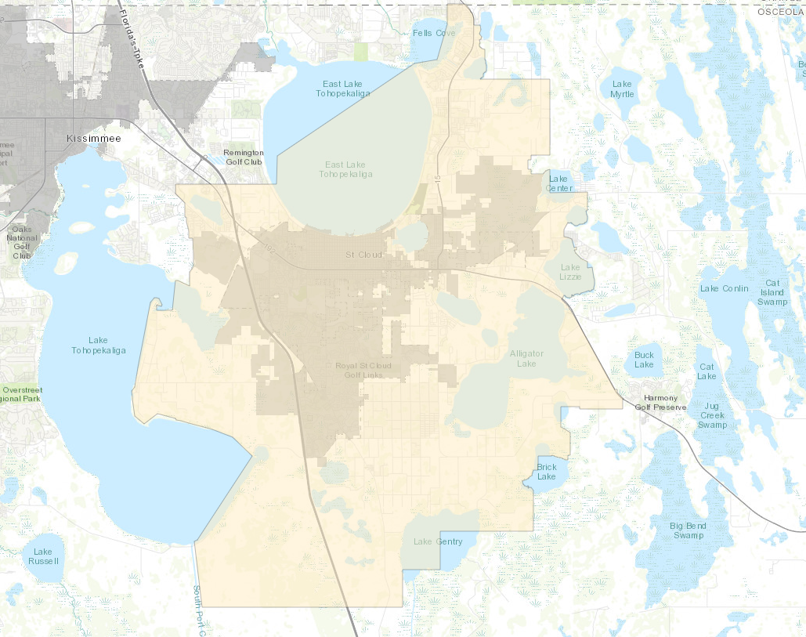
JPA Transportation Implementation
Osceola County & City of St. Cloud
Joint Planning Area Transportation Implementation (JPA-TI) Activities:
Initial Roadway Maintenance Transfer
JPA Transportation Inter-Local Agreement (ILA)
Future Roadway Maintenance Transfer
Initial Roadway Build-Out Coordination
Joint Mobility Fee Study Update
Notes:
As this area grows, careful planning and coordination need to occur between Osceola County and the City of St. Cloud. In 2014 both Osceola County and the City of St. Cloud signed an Interlocal Agreement approving the Joint Planning Area, or JPA. This agreement is often simply referred to as “The JPA”. This JPA outlines different aspects of governance that are coordinated including, the order and areas of annexation and how transportation can be coordinated between both Osceola County and the City of St. Cloud.
The County and City are developing a Transportation Implementation Strategy, known as the JPA-TI. Some key elements of this JPA-TI include completing the initial roadway maintenance transfer for roadways previously annexed, drafting a Transportation Inter-Local Agreement that will address the future roadway maintenance, planned roadway built-out responsibilities, work program coordination, and joint mobility fee study update.

Slide 14

Consider public comments
Finalize SEATS analysis and related Phasing Plan
Present to the Osceola County Commissioners (Planned for April 17th)
Present to St. Cloud City Council (Planned for April 27th)
Coordinate developer agreements
Coordinate with St. Cloud on the JPA-TI
Notes:
The next steps include:
Compiling and summarizing comments from the Community Open House for consideration.
Finalizing the SEATS analysis and related Phasing Plan.
Present to the Osceola County Board of County Commissioners (Planned for April 17th).
Present to the City of St. Cloud City Council (Planned for April 27th).
Continue to coordinate with the 12 developers to draft Agreements addressing how each will contribute to the needed improvements to offset their development’s impacts on future traffic.
And continue coordinating with the City of St. Cloud for the JPA Transportation Implementation activities

Slide 15

How to Submit Your Comments
Southeast Area Transportation Study – SEATS
Fill out a printed comment form at the meeting
Email comments to Joshua.Devries@osceola.org
Please return any comments by April 3, 2023, to be included in the meeting’s public record.
Notes:
Osceola County welcomes your opinions on the Southeast Area Transportation Study. To submit your comments, please fill out a printed comment form during tonight’s meeting and drop it in one of the comment boxes before you leave. You may also email comments to Joshua DeVries at ,Joshua.DeVries@osceola.org. While feedback is accepted at any time, please submit your comments by April 3, 2023 to be included in the public record for this meeting.

Slide 16
For More Information
Joshua DeVries, AICP, Director
Transportation Planning
Osceola County
Transportation and Transit
1 Courthouse Square, Suite 3100
Kissimmee, FL 34741
407-742-7813
Joshua.DeVries@Osceola.org
Steven Kane, P.E., Director
Osceola County
Transportation and Transit
1 Courthouse Square, Suite 3100
Kissimmee, FL 34741
407-742-0513
Steven.Kane@Osceola.org
Notes:
If there are any questions relating to this presentation you may contact Joshua DeVries, Director of Transportation Planning, by email at joshua.devries@osceola.org or by phone at 407-742-7813; or Steven Kane, Transportation and Transit Director, by email at steven.kane@osceola.org or by phone at 407-742-0513.

Slide 17
Thank you
Notes:
Thank you for your time, and please enjoy the rest of your evening.

