Slide 1
Local Mitigation Strategy Working Group
Regular Meeting- June 11, 2026
The School District of Osceola County

Slide 2
Agenda
Attendance
Approval of Agenda
Membership Updates
Approval of Minutes
Hear the Audience
Committee Reports
Project Priority List
Discussion Items
Adjournment

Slide 3
Attendance

Slide 4
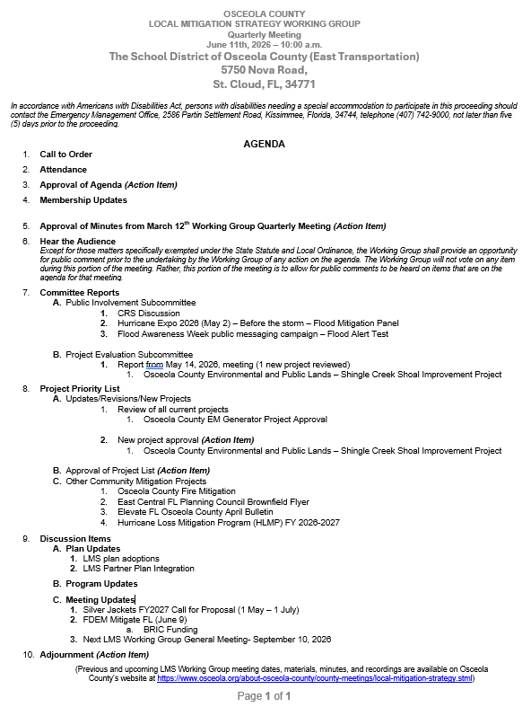
Approval of Agenda

Slide 5
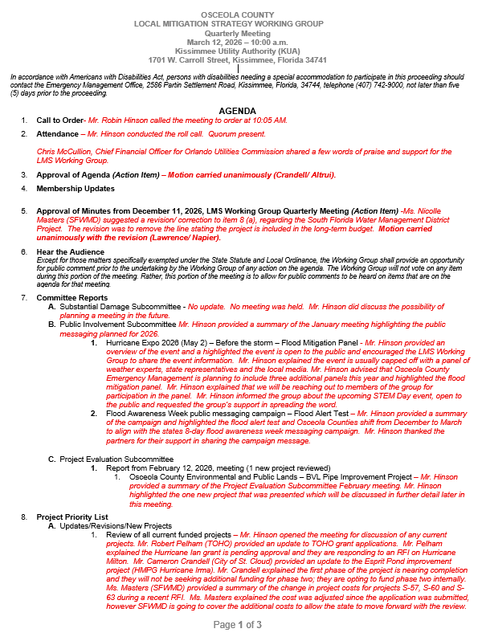
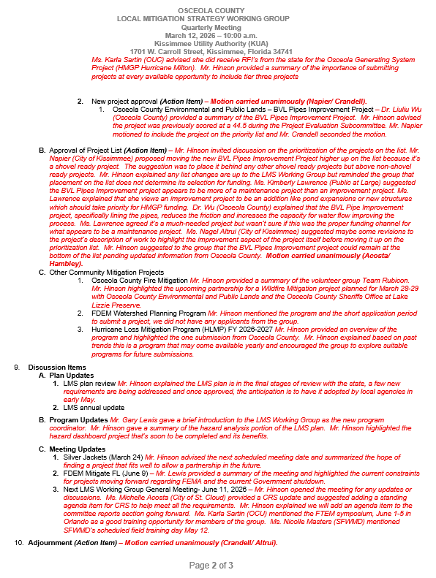
Approval of Minutes

Slide 6
Hear the Audience
Except for those matters specifically exempted under the State Statute and Local Ordinance, the Working Group shall provide an opportunity for public comment prior to the undertaking by the Working Group of any action on the agenda. The Working Group will not vote on any item during this portion of the meeting. Rather, this portion of the meeting is to allow for public comments to be heard on items that are on the agenda for that meeting.

Slide 7
Committee Reports
Substantial Damage Subcommittee
Public Involvement Subcommittee
  CRS Discussion
  Hurricane Expo 2026 (May 2) – Before the storm – Flood Mitigation Panel
  Flood Awareness Week public messaging campaign – Flood Alert Test
Project Evaluation Subcommittee – Report (May 14) – 1 new project reviewed
  Osceola County Environmental and Public Lands – Shingle Creek Shoal Improvement Project

Slide 8
Project Priority List
Updates
Open discussion on updates of current projects
  Review all current approved projects
    Osceola County EM Generator Project
  Vote to add new projects to the list (Action Item)
    Osceola County Environmental and Public Lands – Shingle Creek Shoal Improvement Project
  Approve the LMS Priority List (Action Item)
  Vote to select the projects for HMGP Milton funding (Action Item)
  Other community mitigation projects
    Osceola County Fire Mitigation
    East Central FL Planning Council Brownfield Flyer
    Elevate FL Osceola County April Bulletin
    Hurricane Loss Mitigation Program (HLMP) FY 2026-2027

Slide 9
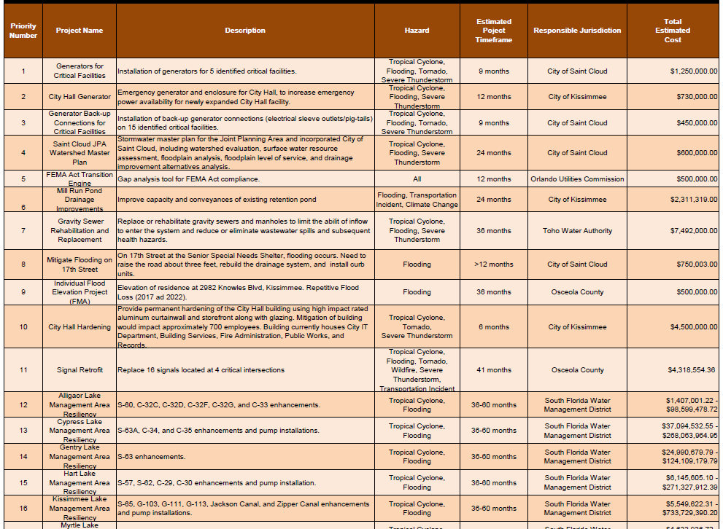
Project Priority List
Approval of Project List

Slide 10
Discussion Items
Plan Updates
  LMS Plan Adoptions
  LMS Partner Plan Integration
Program Updates

Slide 11
Discussion Items
Meeting Updates
Silver Jackets FY2027 Call for Proposal (1 May – 1 July)
FDEM Mitigate FL (June 9)
  BRIC Funding
Next LMS Working Group General Meeting – September 10, 2026

Slide 12
Adjournment

Slide 13
Local Mitigation Strategy
Working Group
Next Regular Meeting- September 10, 2026
  Previous and upcoming LMS Working Group meeting dates, materials,
  minutes, and recordings are available on Osceola County’s website at
https://www.osceola.org/about-osceola-county/county-meetings/local-mitigation-strategy.stml

